Slide 1



Southern Synod – Big Day out

Slide 2


Fun Fellowship Food
Saturday 20th June 2026
Shires Oast
Tunbridge Wells
10 - 4

Slide 3

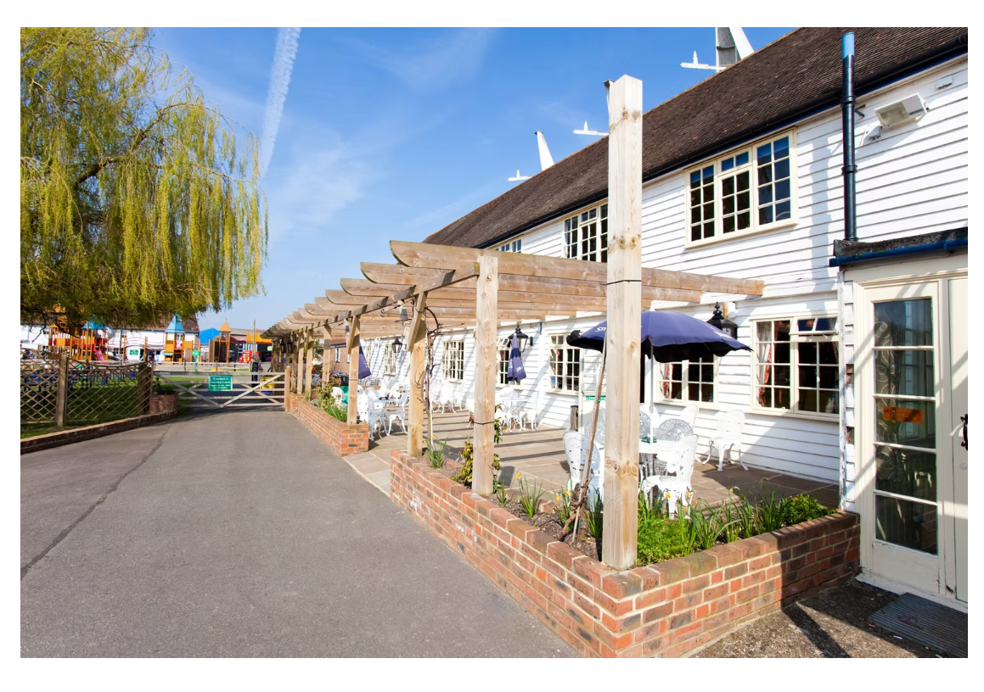
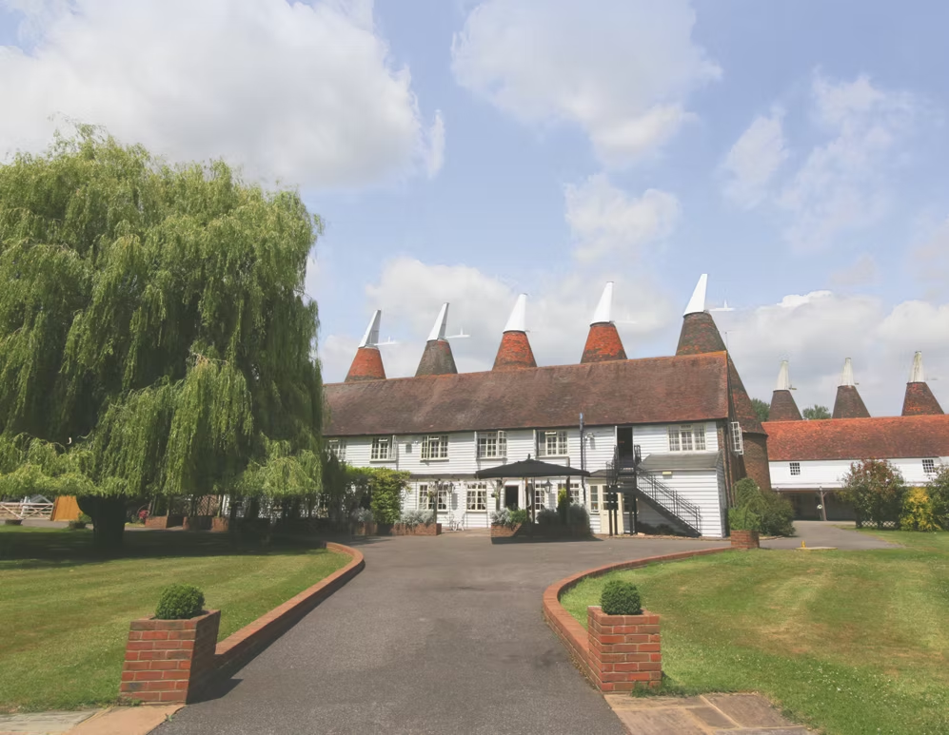
Welcome to

Slide 4
Purpose- A joyful gathering for the entire Synod to:
Worship and share agape together,
Celebrate and showcase ministry initiatives from across congregations,
Enjoy fellowship, food, and fun in a relaxed, family-friendly setting.

Slide 5

Activities:
Opportunity to worship together – under a marque

Slide 6




Workshops led by congregations

Slide 7


Slide 8
Prayer spaces for quiet reflection

Slide 9

Pop-up choir/choral event/gospel sing-along

Slide 10


Bouncy castles and inflatable games for the whole family

Slide 11

£5 per person
Included in the cost is a burger and soft drink
(bar will be available to buy food and drink; own food welcome too)

Slide 12

To join the organising team
To spread the news to your congregations
To help out on the day
To share ministry initiates with others
Contact Ruth at ruthlucy@live.com
or 07778 689 872
for more info

